Slide 1
ELECTROMAGNETIC SPECTRUM Group name:(ASI) Group MEMBERS :
Asjid Tahir Hassan Subhani ibrar babar

Slide 2
What is the Electromagnetic Spectrum?
The electromagnetic spectrum is the complete spectrum (or continuum) of all forms of “light”
An electromagnetic wave consists of electric and magnetic fields which vibrate - thus making waves.
Vibrations

Slide 3
Waves
Properties of electromagnetic waves include speed, frequency and wavelength
Speed (s), frequency (f) and wavelength (l) are related in the formula:
s = f x l
All light waves travel at a speed of 3 x 10⁸ m/s in a vacuum.

Slide 4
Relationship Between Wavelength & Frequency
All parts of the electromagnetic spectrum travel at the same speed
Therefore, wavelength and frequency have an indirect relationship.
This means that as one characteristic increases, the other decreases
In other words, as wavelength increases, frequency decreases

Slide 5
Working of Electromagnetic Spectrum :
Radio waves ,gamma rays ,visible light and the other parts of the electromagnetic spectrum are electromagnetic radiations.
Electromagnetic radiations are descried in terms of a steam of mass less particles called photons.
Each photon travelling at same speed of light.

Slide 6
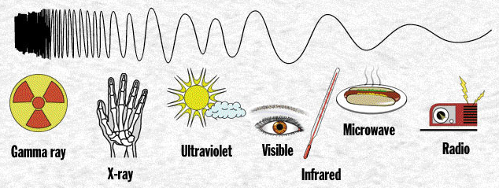

Slide 7
Features:
Radio waves.
Microwaves.
Infrared waves.
Visible light waves.
Ultraviolet waves.
X-ray waves.
Gamma waves.

Slide 8
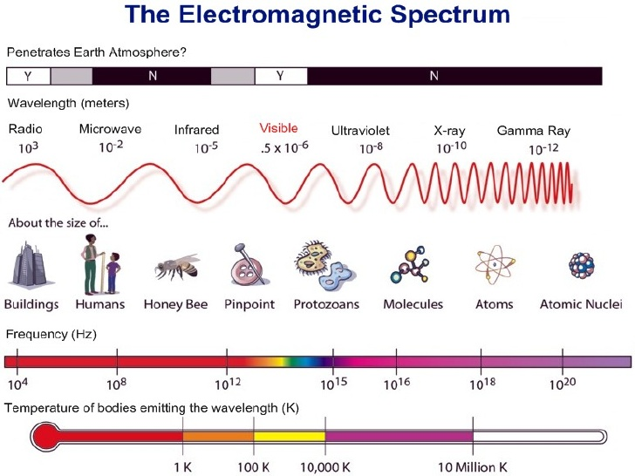

Slide 9
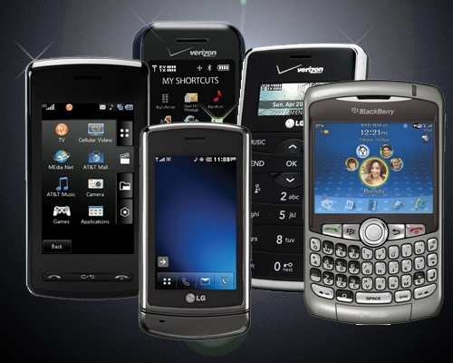
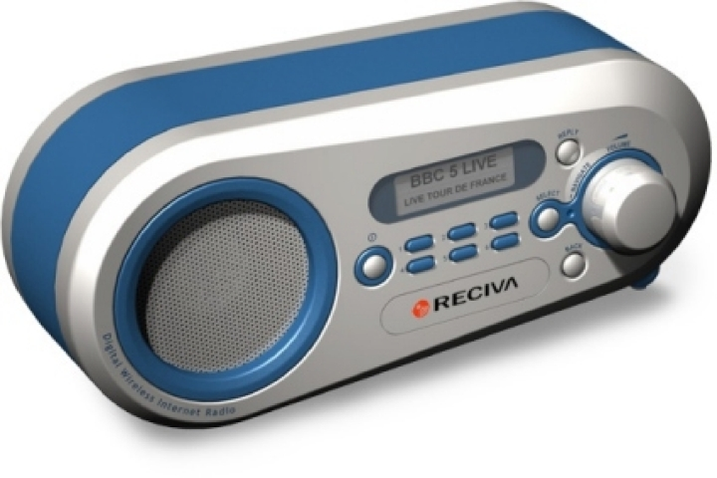
Radio Waves
Low energy waves with longest wavelengths
Low frequency
Includes FM, AM, TV waves etc.
Used in many devices such as remote control items, cell phones, wireless devices, etc

Slide 10
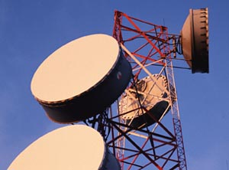
Micro Waves
Wavelength less then radio wave.
Frequency large then radio wave.
Include transmission towers, radar etc.
Three types: (EHF , SHF , UHF)
Use for sonar system(remote sensing), microwaves ovens , satellite communication etc.

Slide 11
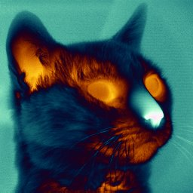
Infrared Waves
Invisible electromagnetic waves that are detected as
heat.
Include thermal radiations emitted by object at room temperature
Can be detected with special devices such as night goggles
Used in heat lamps
Higher energy than microwaves but lower than visible light

Slide 12
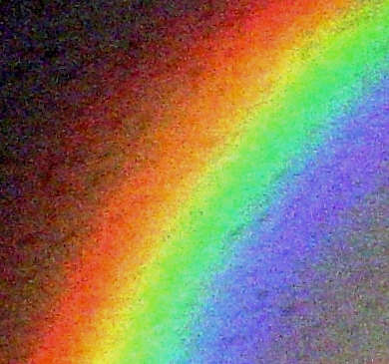
Visible Light
The portion of the electromagnetic spectrum that human eyes can detect
ROY G BIV (red, orange, yellow, green, blue, indigo, violet)
Which color has the lowest frequency?
red has the lowest frequency – violet the highest

Slide 13
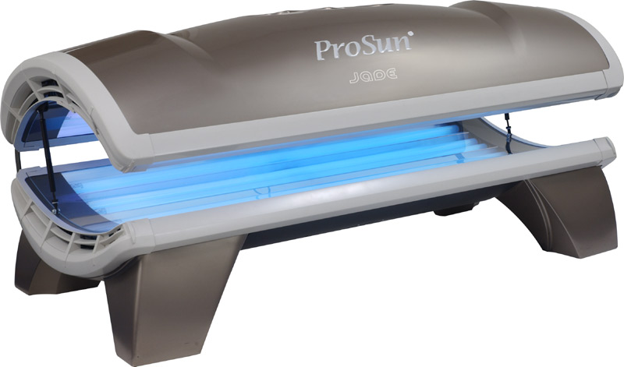
Ultra Violet Waves
Higher energy than light waves
Can cause skin cancer and blindness in humans
Used in tanning beds and sterilizing equipment

Slide 14
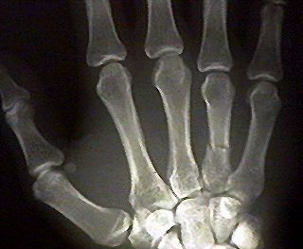
X-Rays
High energy waves
Used in medicine, industry and astronomy
Can cause cancer

Slide 15
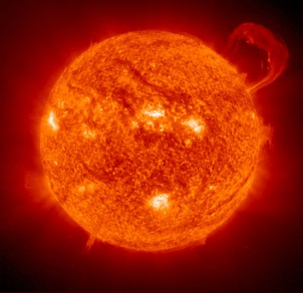
Gamma Rays
Highest energy
Blocked from Earth’s surface by atmosphere

Slide 16
ANY QUESTION ????? THANK YOU!!!!!!!!

